Slide 1

Department of ICT
B.E Sem : IV ICT MU
Subject Name: Probability and Statistics Subject code : 01CT0401
Unit no. 1
Unit title: Introduction to Probability
Faculty Name:
Foram

Slide 2
Unit -2 Random Variable

Slide 3
Random Variable
A random variable is a random process that assigns a numerical value to each outcome in a sample space. Random variables may be either discrete or continuous.
The random variable is denoted by capital letters such as X, Y, Z,….

Slide 4
Example:
When we toss 2 coins together, Sample Space is ,
S = { HH, HT, TH, TT }
let us define a function X on S such that
X= Number of heads ;
This X is known as random variable and the set {2,1,0} is called range of a random variable X.

Slide 5
Discrete and Continuous Random Variables
(a) Discrete Random Variable
If the range of a random variable X is finite or an infinite
sequence of numbers, then it is called a discrete
random variable. For example, when we deal with
counting vehicles on road, number of students in class,
number of children born in 2020
(b) Continuous Random Variable
If the range of a random variable X contains interval of R,
then it is called a continuous random variable. For
example, when we deal with measuring height of
students in a class, weight of kids, etc. then we have
continuous random variable.

Slide 6
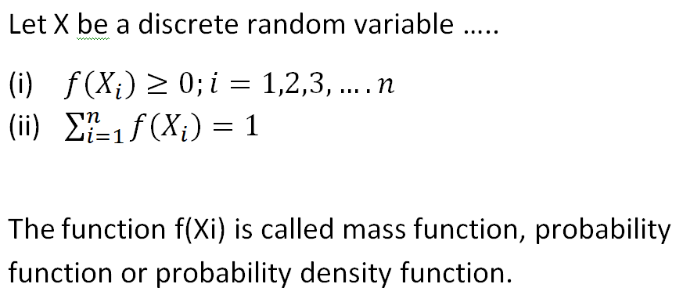
Probability Mass Function

Slide 7
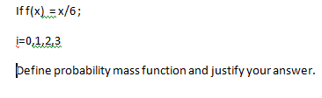
Example

Slide 8
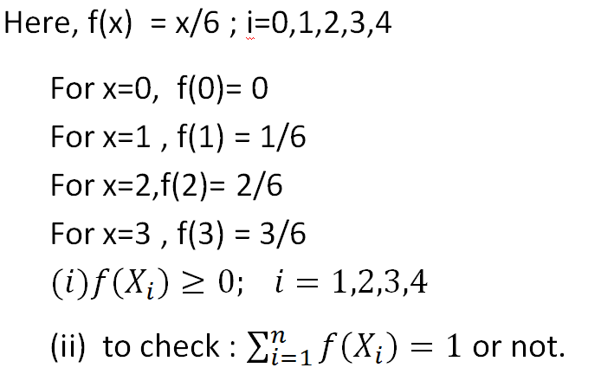
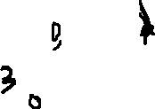
Solution

Slide 9
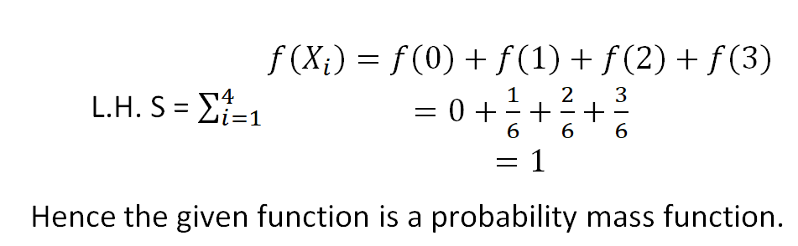


Slide 10
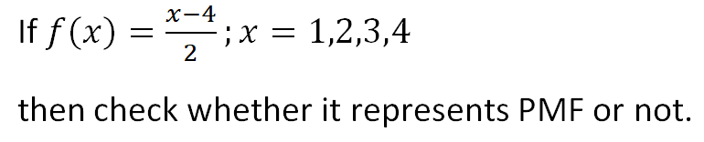

Example

Slide 11
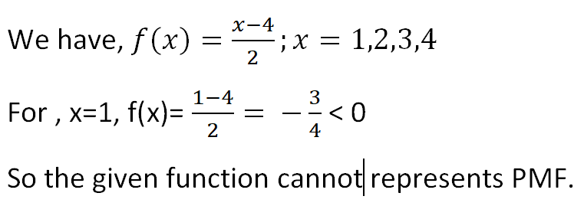

Solution

Slide 12
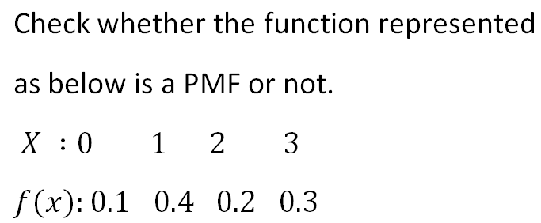
Example

Slide 13
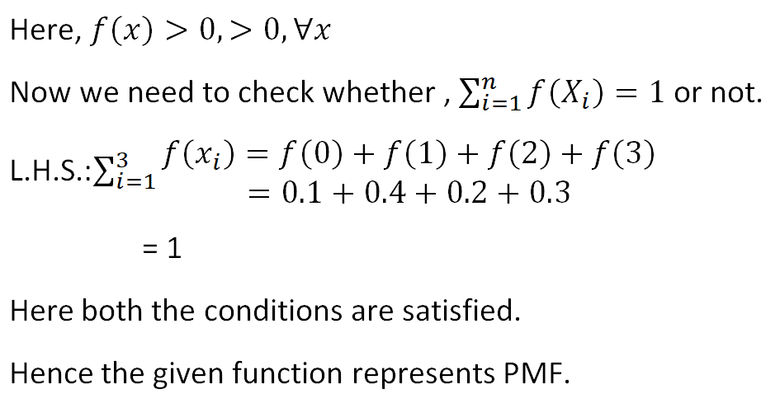

Solution

Slide 14
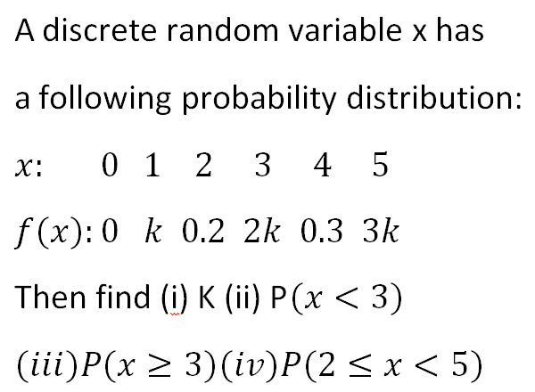

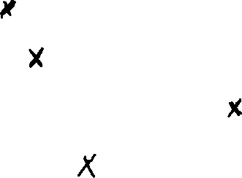
Example

Slide 15
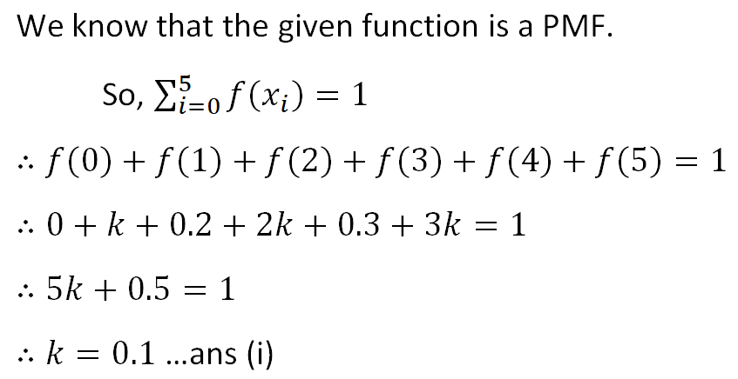
Solution

Slide 16
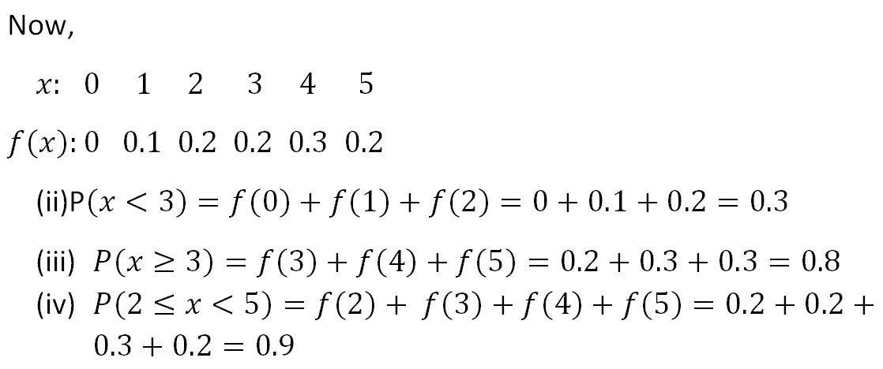
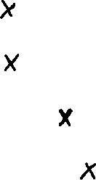

Slide 17
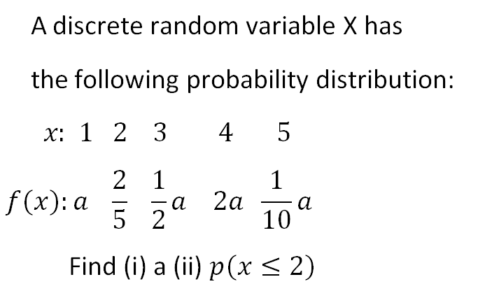
Example

Slide 18
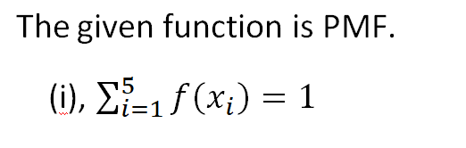
Solution

Slide 19
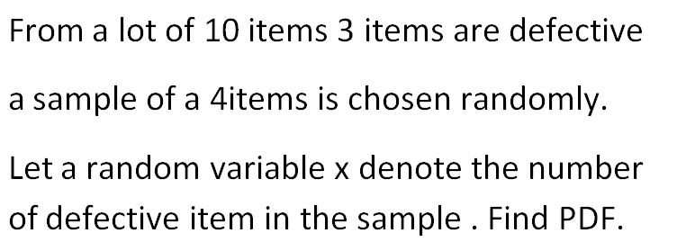
Example

Slide 20
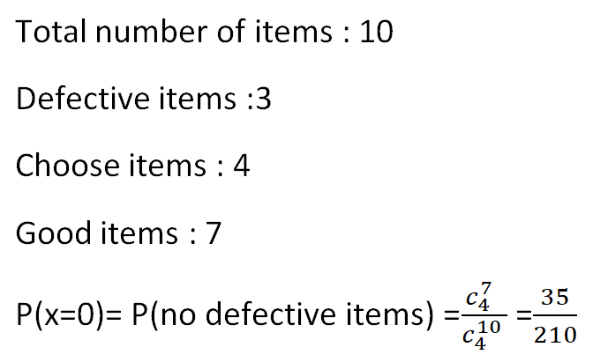
Solution

Slide 21
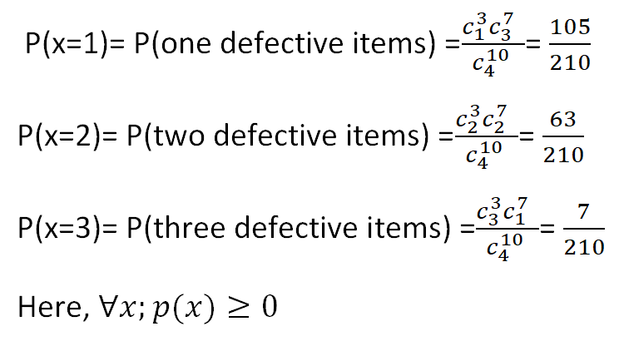

Slide 22
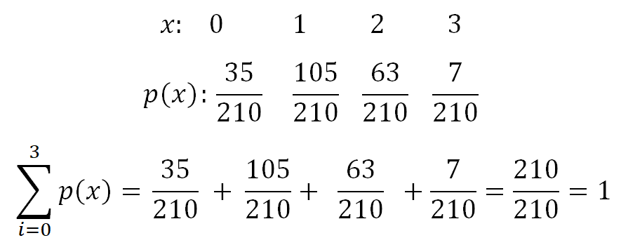

Slide 23
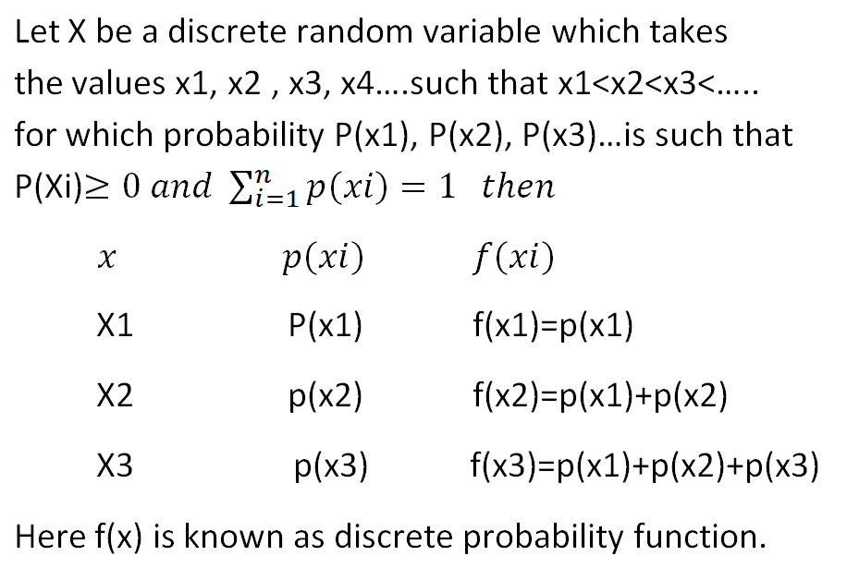
Discrete distribution function

Slide 24
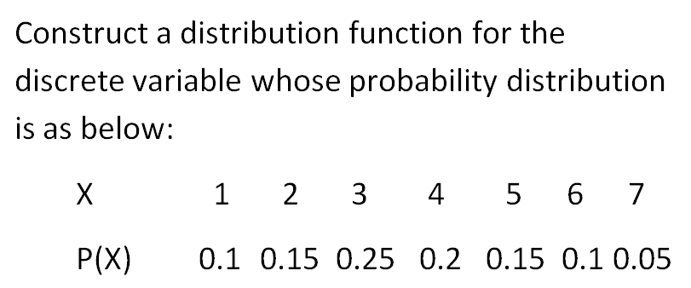
Example

Slide 25
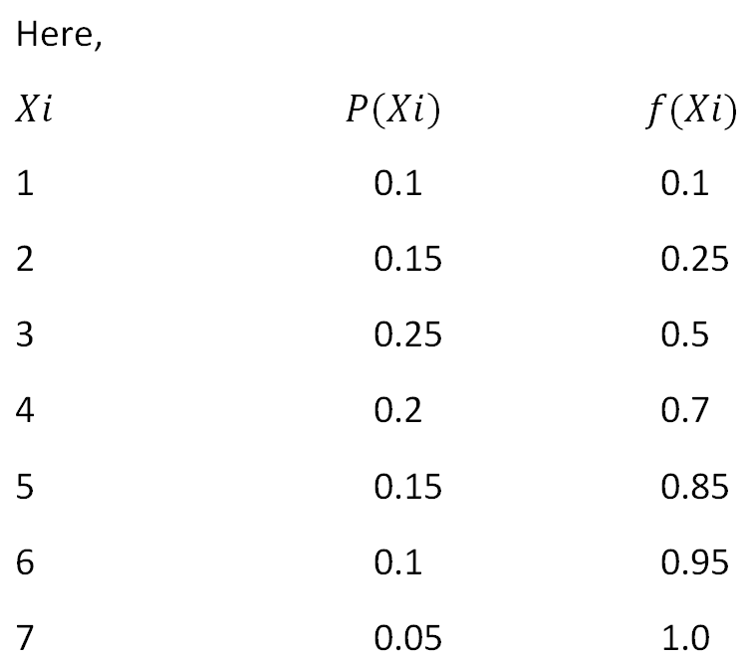
Solution

Slide 26
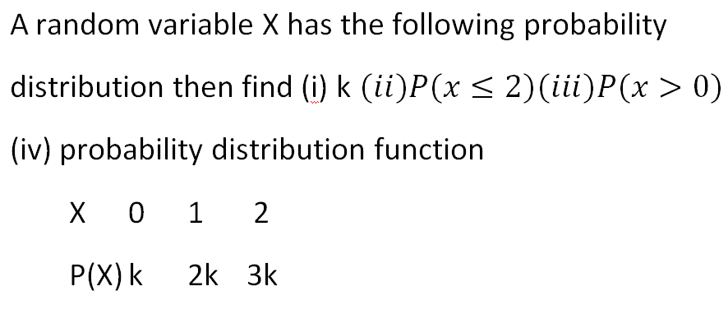
Example

Slide 27
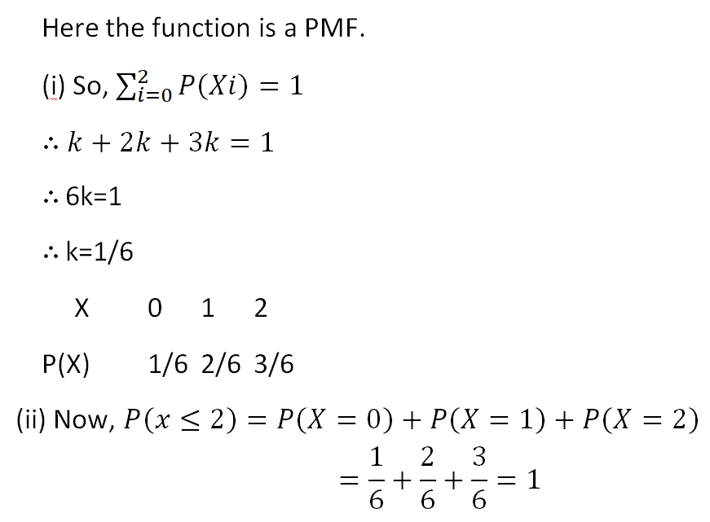
Solution

Slide 28
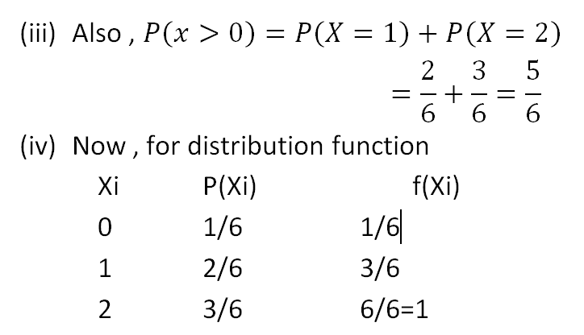

Slide 29

Mathematical Expectation, Variance and Standard deviation
Mathematical Expectation: Let x1, x2,x3… be the discrete random variable and P(x1),P(x2), P(x3),,….are the probabilities then expectation can be given as,

Slide 30
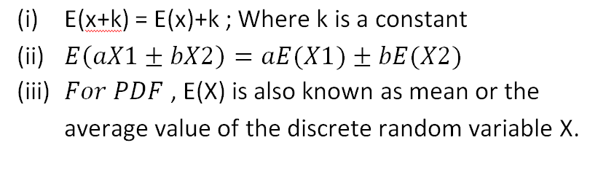
Properties

Slide 31
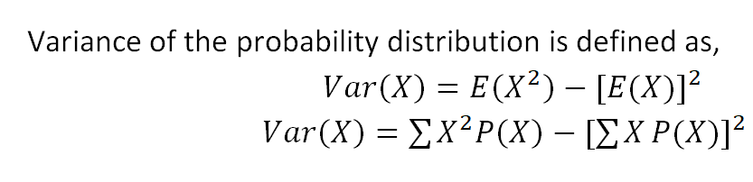
Variance

Slide 32
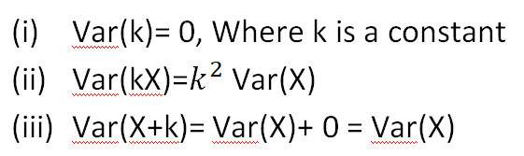
Properties

Slide 33
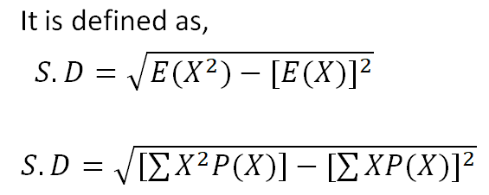
Standard deviation

Slide 34
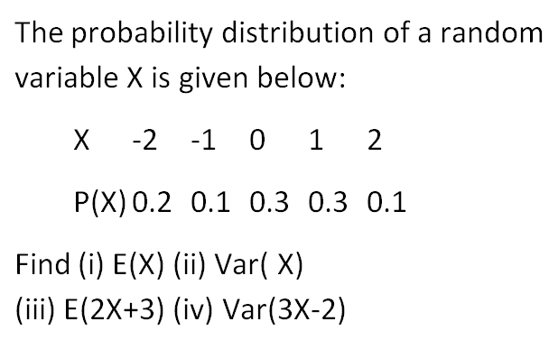
Example

Slide 35
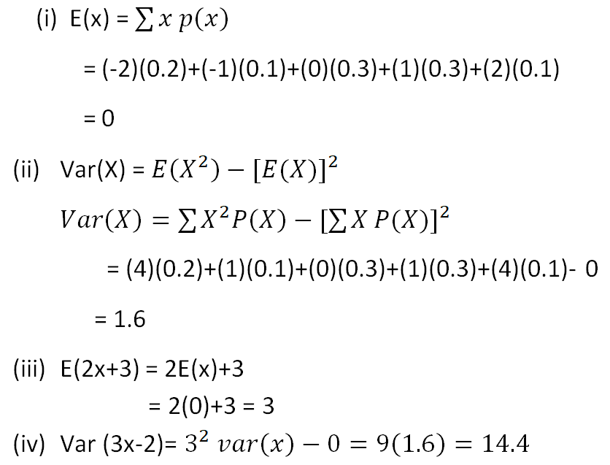
Solution

Slide 36
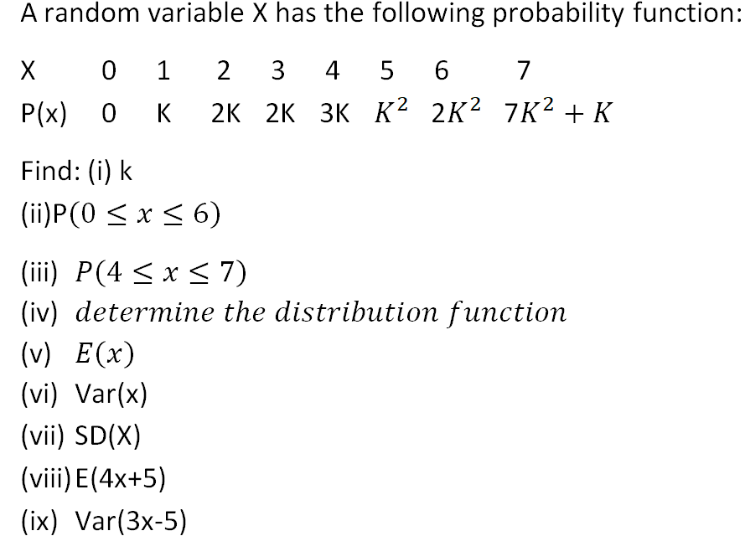
Example 23

Slide 37
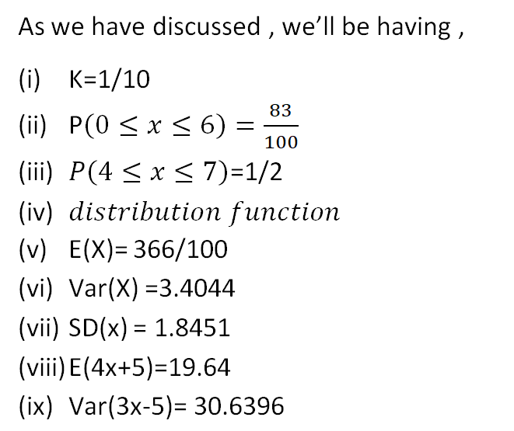
Solution

Slide 38
Example
A bag contains 8 items of which 2 are defective. A man selects 3 items at random. Find the expected number of defective items he has drawn.

Slide 39
Solution
Let X be the random variable which defines number of defective items.
X= 0,1,2

Slide 40
Example
A fair dice is tossed. Let the random variable X denotes twice the number appearing on the dice. Write the probability distribution of X. Calculate the mean, variance and distribution function for X.

Slide 41
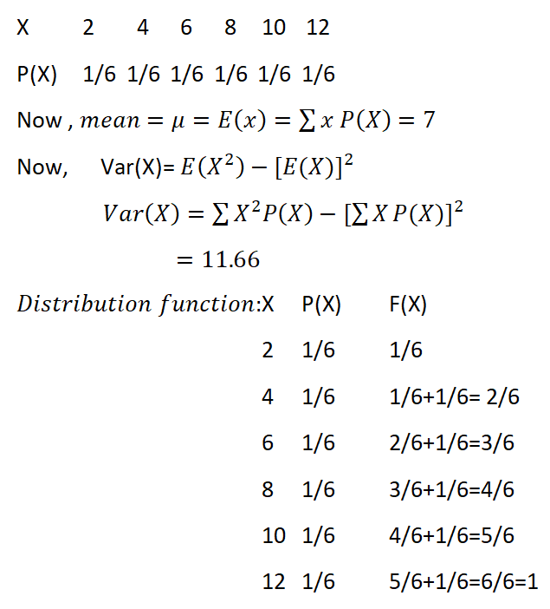
Solution

Slide 42
Example 25
A player tosses two fair coins he wins 100 rs if a head appears and 200 rs if two head appears on the other hand he losses 500 rs if no head appears. Determine the expected value of the game. Is the game favorable to all the players?

Slide 43
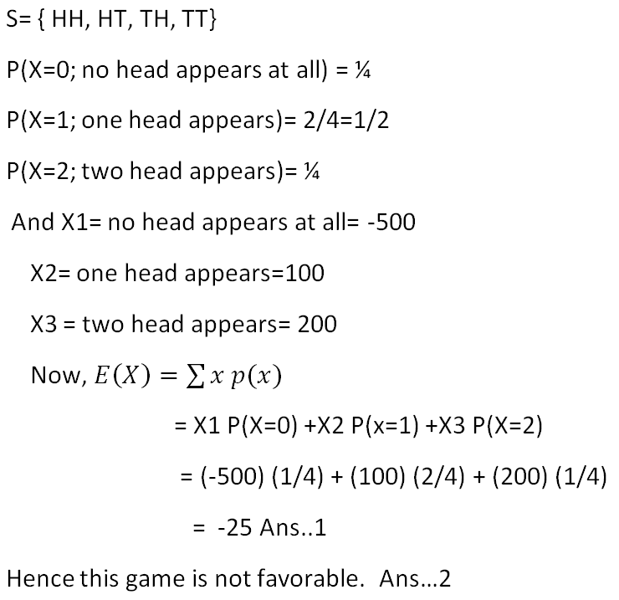
Solution

Slide 44
Example 26
A game of tossing a dice. If a number less than three appears he gets “a” rs and otherwise he has to pay 10 rs . If the game is fair , find the value of a.

Slide 45
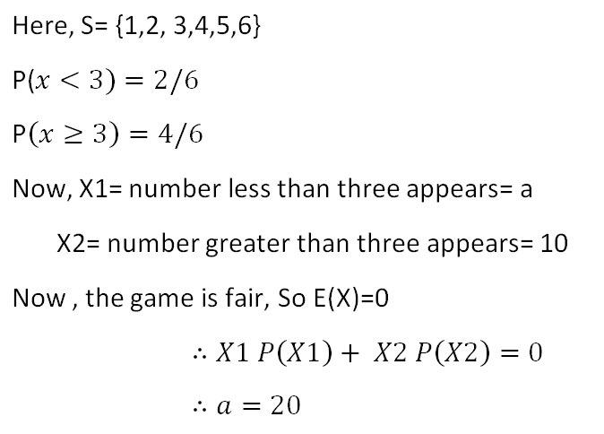
Solution

